Slide 1

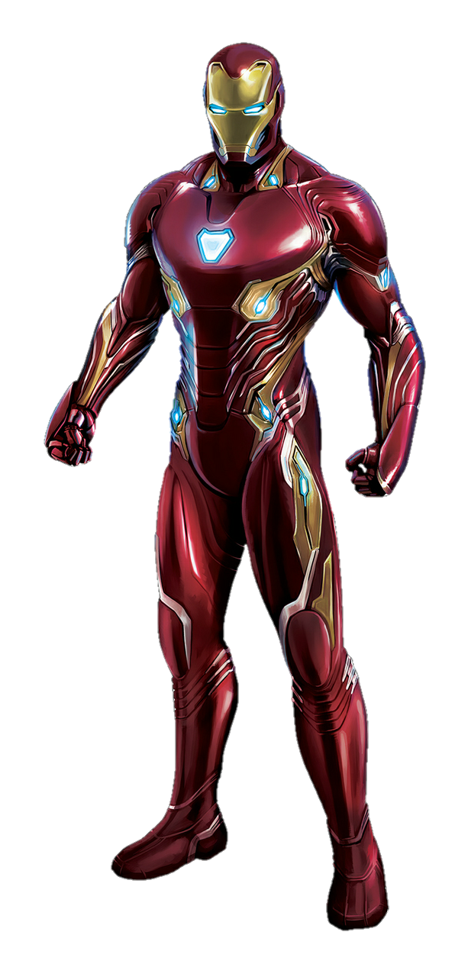
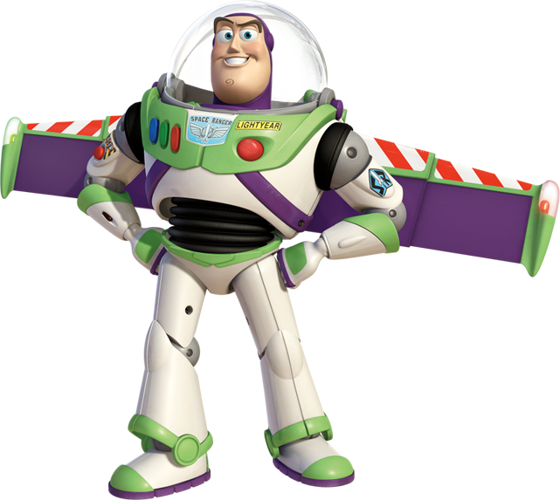
Application Based Teaching – From Iron Man to Buzz Lightyear and Everything in Between
Pat Riley
Hopkinsville Community College (KY)

Slide 2

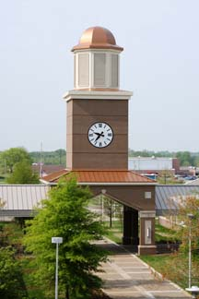
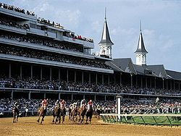

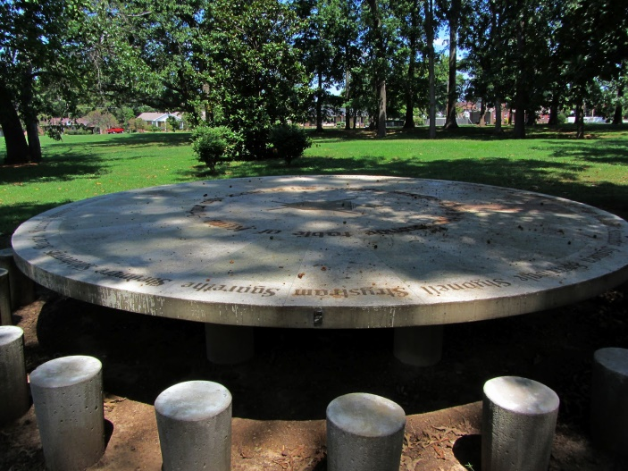
Pat Riley
Hopkinsville Community College (KY)

Slide 3
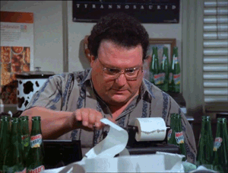
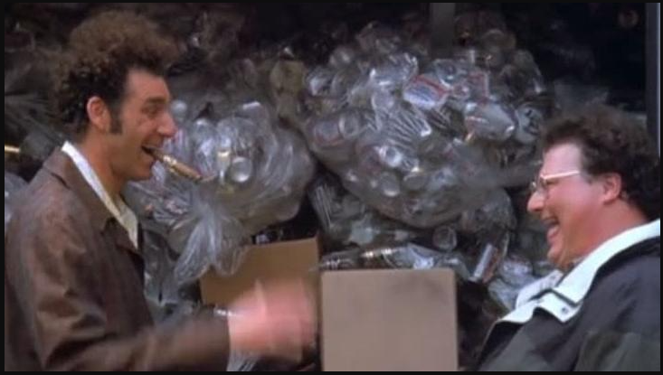
Two Key Moments 1. When will I ever use this? 2. Seinfeld Can/Bottle Scam

Slide 4
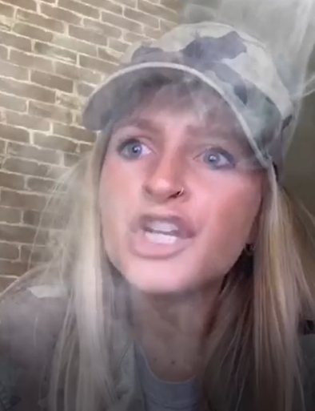
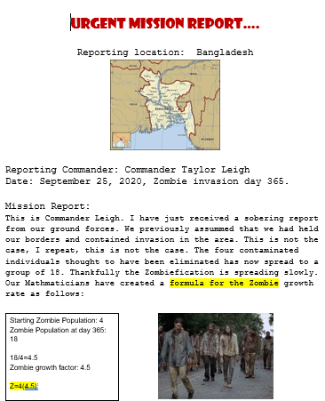
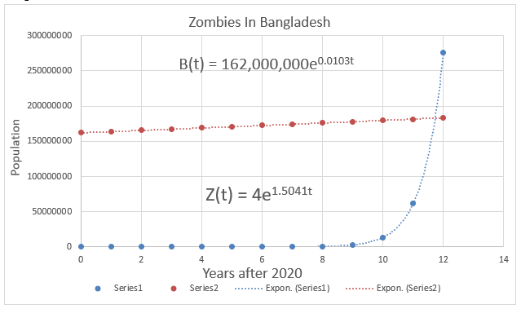
Zombie Apocalypse

Slide 5
Cryptography
C(n) = 5n + 3
83 – 108 – 93 – 28
68 – 48 – 18 – 43 – 48 – 38 – 8 - 73

Slide 6
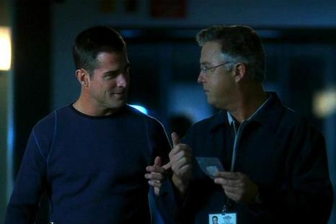
CSI
The coroner reports that the victim’s chest wound measures about 3.25 inches.
According to the lab test, the shooter was
D = 12.571(3.25) – 7.7619
= 33 feet away

Slide 7
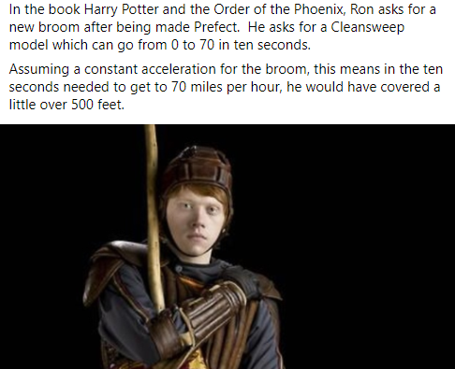
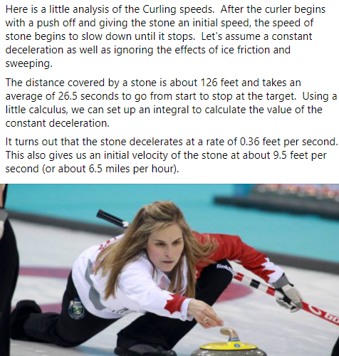
Acceleration / Deceleration

Slide 8
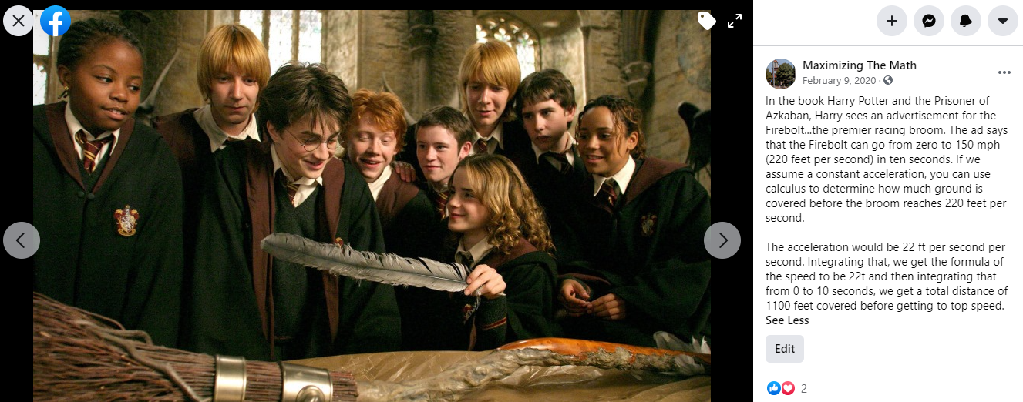
Acceleration / Deceleration

Slide 9
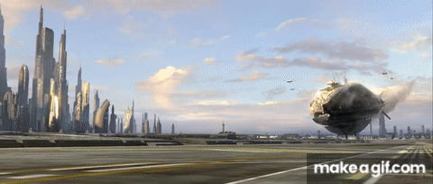
Star Wars

Slide 10
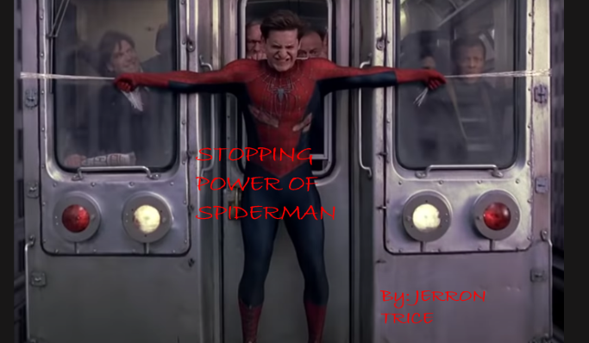
Spiderman Stops Train

Slide 11
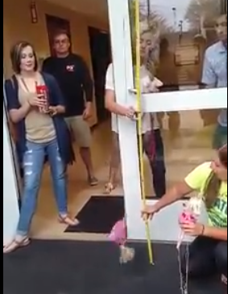
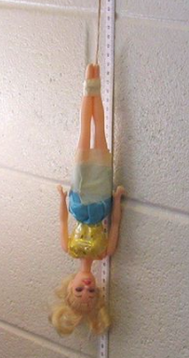
Barbie Bungee

Slide 12
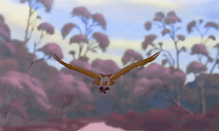
Wing Flaps

Slide 13
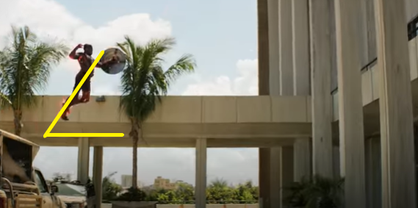
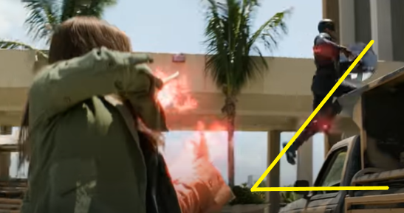
Variables & Setup
Launch Angle: 51 degrees
Time: 1.88 seconds to complete projectile (7.52 seconds on 0.25 speed)
Initial Velocity (v₀ ): unknown aka what we are solving for
55 degrees + 47 degrees = 102/2 = 51 degrees

Slide 14
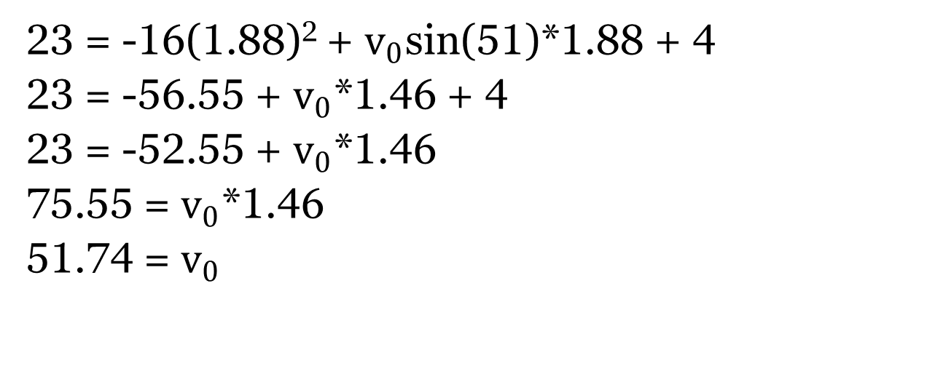
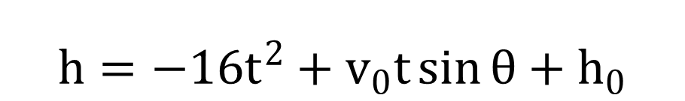
To find initial velocity:
$$h=−16t^{2}+v_{0}t\sin{θ}+h_{0}$$
23 = -16(1.88)² + $v_{0}$sin(51)*1.88 + 4
23 = -56.55 + $v_{0}$*1.46 + 4
23 = -52.55 + $v_{0}$*1.46
75.55 = $v_{0}$*1.46
51.74 = $v_{0}$
Scarlett Witch is launching Captain America an initial velocity of 51.74 ft./sec.

Slide 15
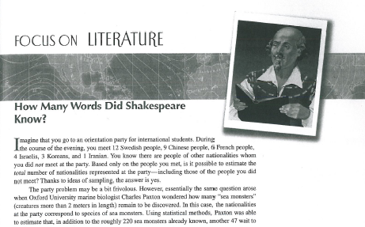
Writing Analysis

Slide 16
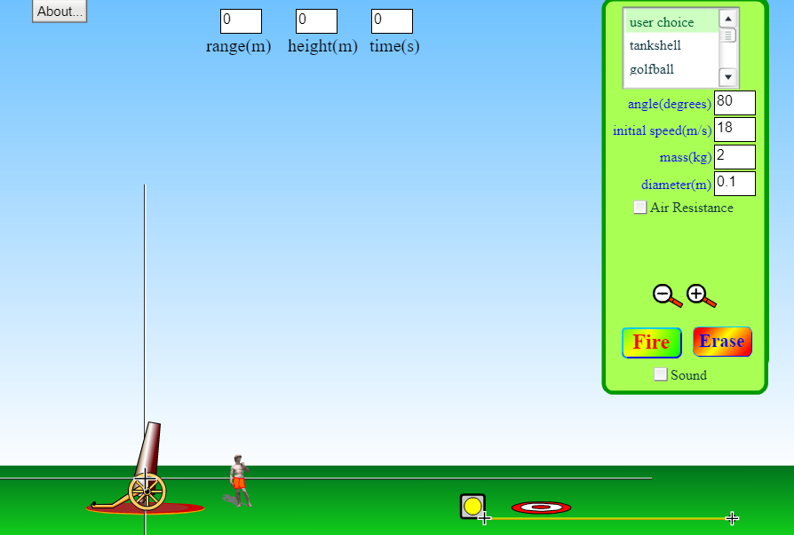
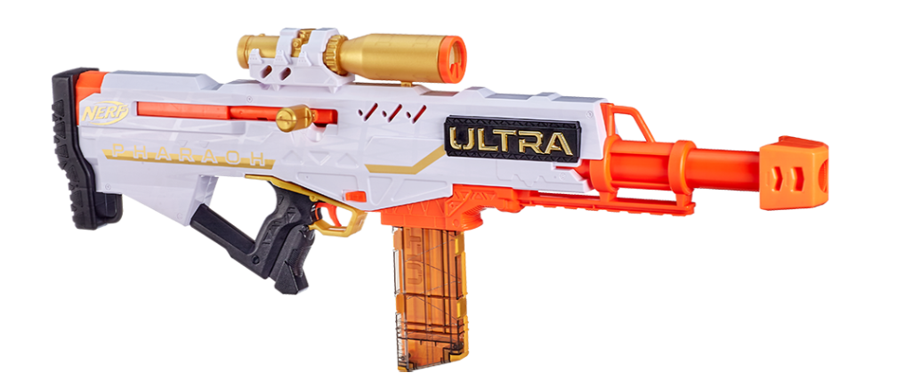
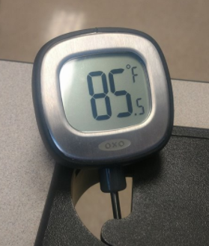

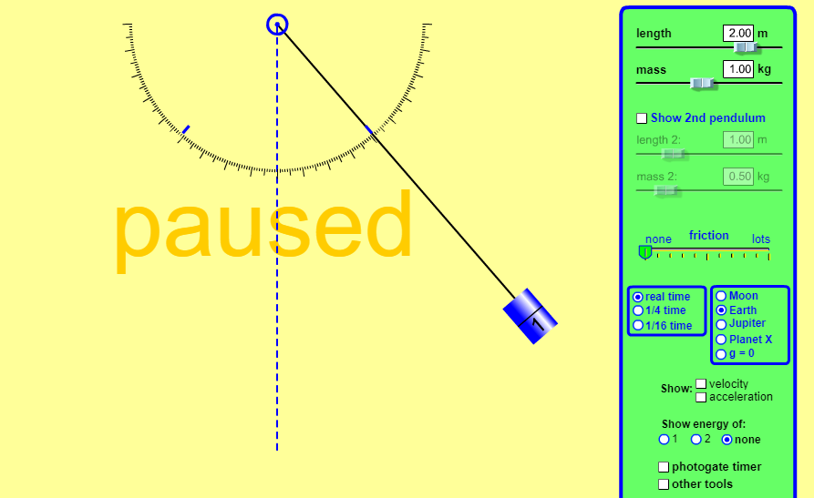
Apps

Slide 17
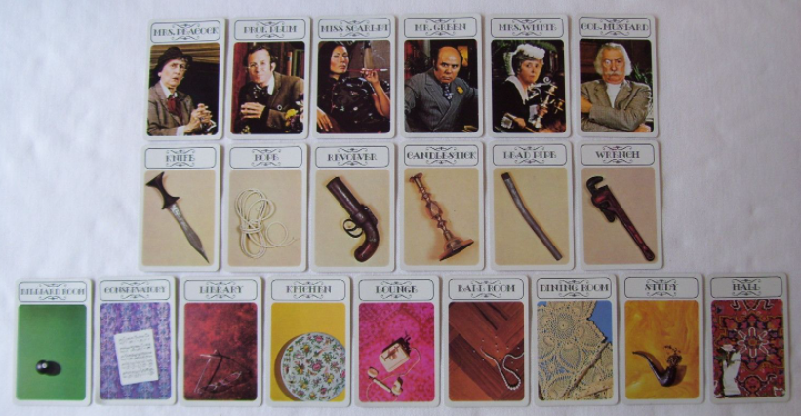
Clue Options

Slide 18
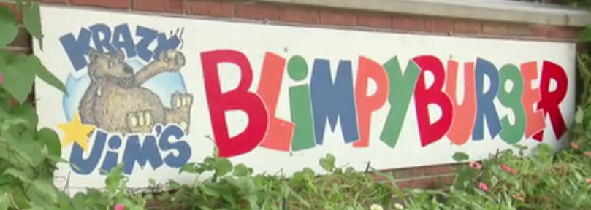
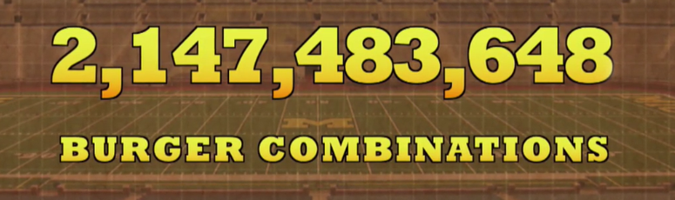
Food Options

Slide 19
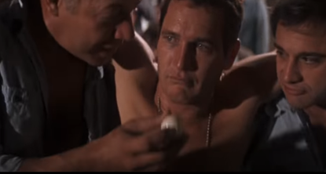
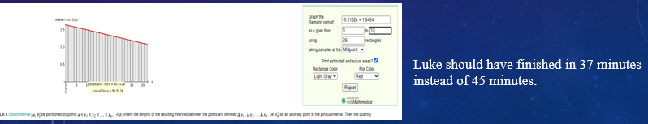
Eating Rates

Slide 20
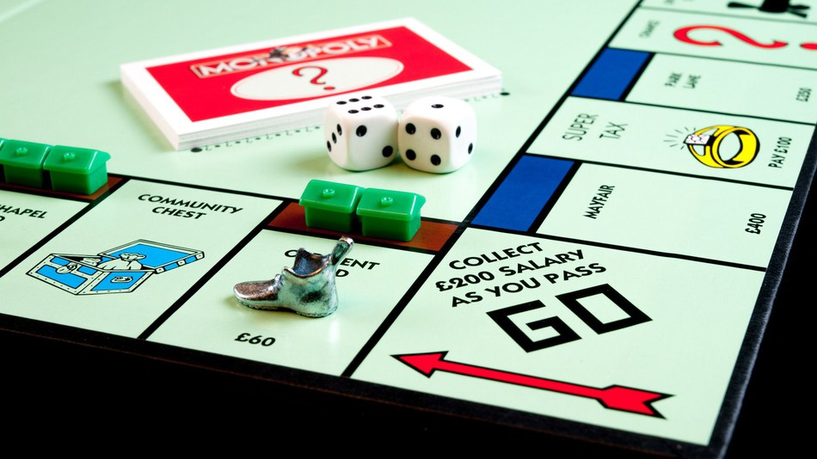
Monopoly

Slide 21
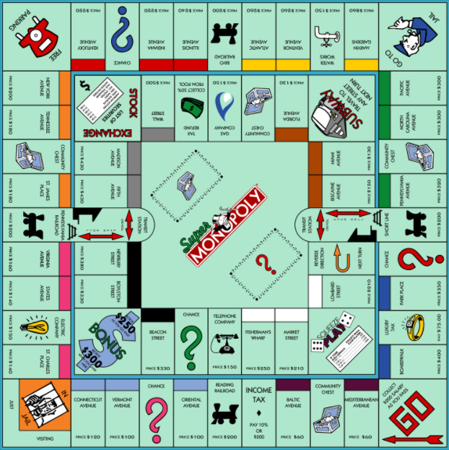
Monopoly

Slide 22
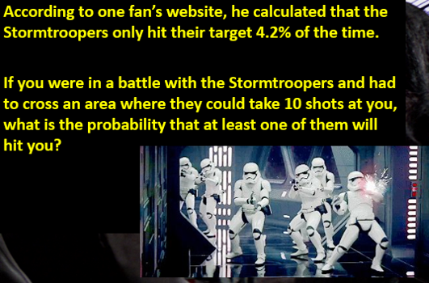
Hit Rates

Slide 23
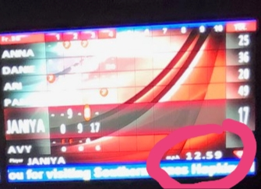
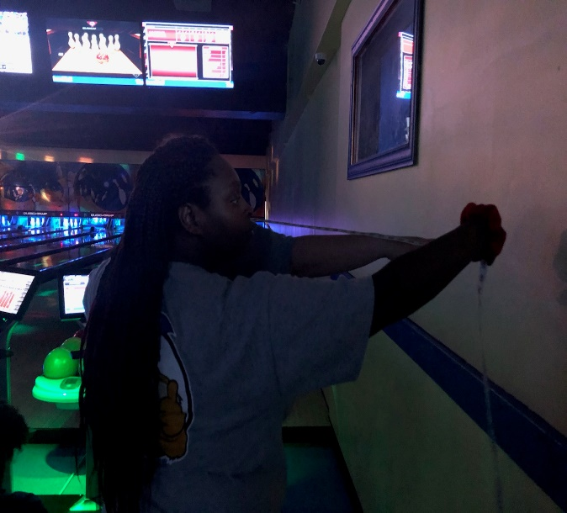
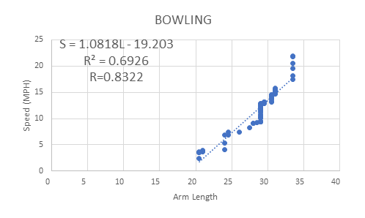
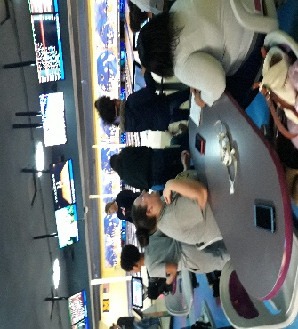
Bowling Project

Slide 24
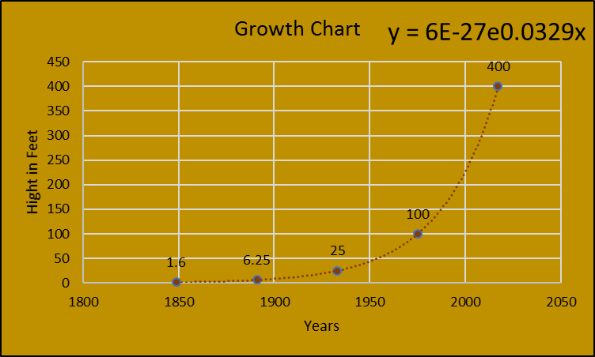
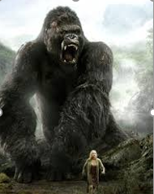
King Kong

Slide 25
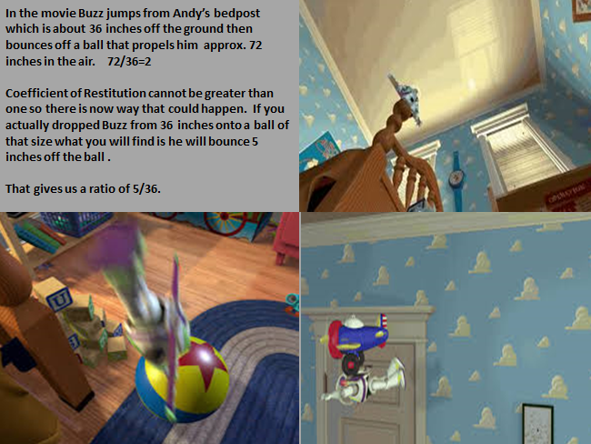
Toy Story maybe my all-time favorite

Slide 26
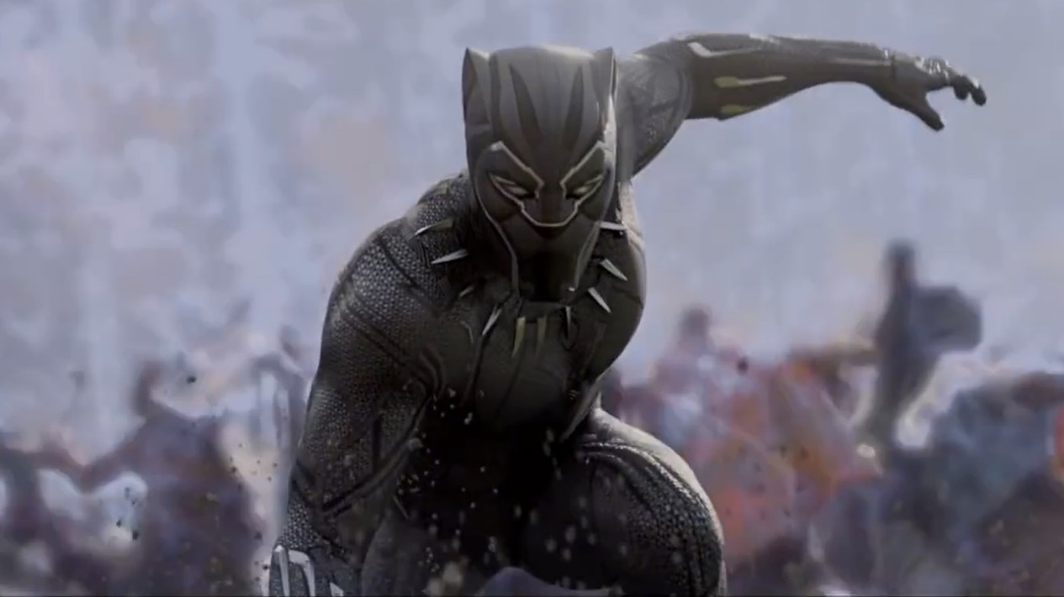
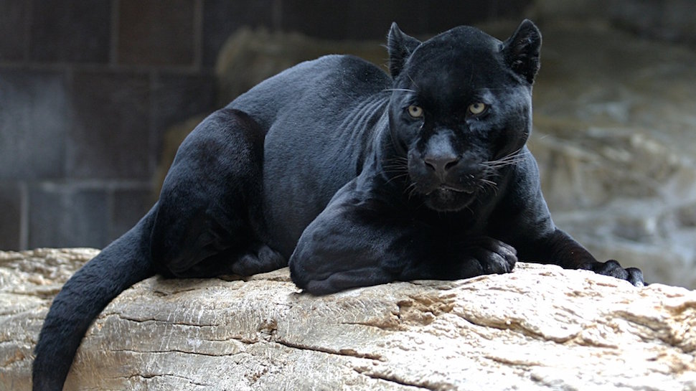
Black Panther

Slide 27
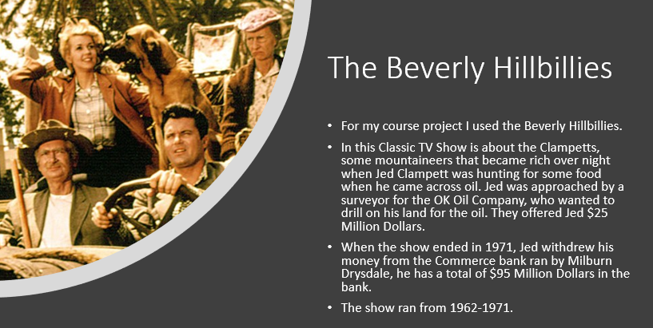
Beverly Hillbillies

Slide 28
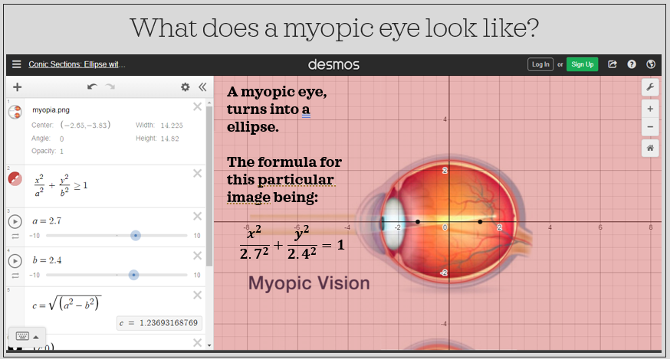
Myopia

Slide 29
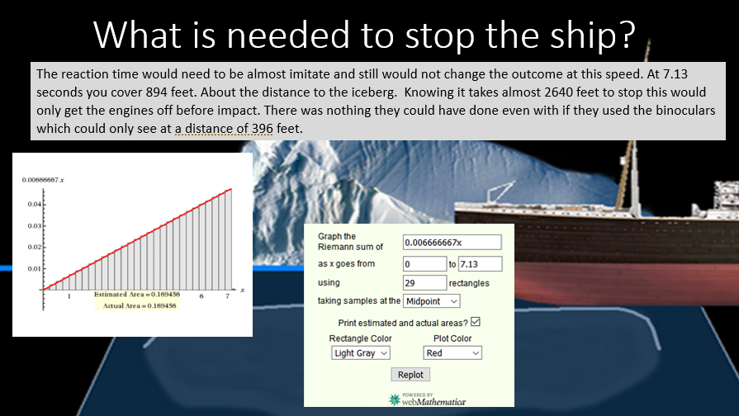
Titanic

Slide 30
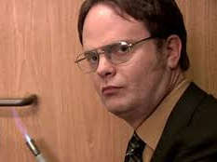
What I Know?
The average temperature of an office building is about 70°.
The average blowtorch temperature can be well over 1,300° and melts aluminum at the point of 1,900° in only about 2 minutes.
When Dwight was torching the metal doorknob it only lasted for about 4 seconds in the video and when the other characters in the show touched it after it had cooled down for approximately 1 minute it was still hot!
The part of the video to watch is from 0.41 seconds to 2 minutes and 15 seconds.
The fourth doorknob touched in the video is the one to look for.

Slide 31
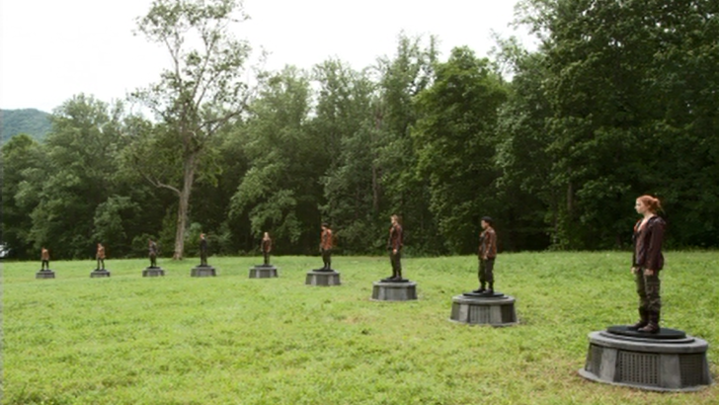
Hunger Games: Action Scene
Averie Turner
MAT170

Slide 32




The Watch Tower/Trees Situation
Tribute A
Tribute B
d
10-d
10 miles distance between two trees
Tribute A’s vision = 5.64 miles
Tribute B’s vision = 4.36 miles

Slide 33

1500 m
13 m/s
d meters
1500 –d
8 m/s
Distance = speed x time
Time = distance / speed
Total Time = time on forest ground + time in the open field (cornucopia)
$$\sqrt{d^{2}+22,500}$$
150 m
T =$\frac{1500−d}{13}$ +$\frac{\sqrt{d^{2}+22,500}}{8}$
$$T=\frac{1500}{13} − \frac{1d}{13}+ \frac{{(d^{2}+22,500)}^{1/2}}{8}$$
T’ = $\frac{−1}{13}+\left(\frac{1}{2}\right)\frac{{(d^{2}+22,500)}^{1/2}}{8}$ x 2d
Safe Area
(NO KILLER BEES)

Slide 34

The Board…
You want to avoid the three spots with black dots, when you land here you will lose a turn. The spots are “Stuck on a Gooey Gumdrop”, “Lost in Lollipop Woods”, and “Stuck in Molasses Swamp”
You will have a great advantage if you can land on the first orange square and do the rainbow trail. You can also get a slight advantage by landing on the purple that allows you to go through gumdrop pass.

Slide 35
How to win in 4 plays…
- Did you know that you can win the game in just 4 plays?
- First you must draw the Queen Frostine card. If you are the first person to go in the game there is a 1/64 or 1.56% that you can draw this card. If you are the second player and the first player did not draw this card you have a 1/63 or 1.59% chance of drawing this card.
- Lets pretend you are player one and player two drew a double red their first time and you drew frostine, Next you must draw 1 of the double cards there is 22 in total but now there is only 21 because player one drew a double red. So you have a 21/62 or 33.87% of drawing the card that you need.
-You drew a double purple congrats. Now you must draw another double but here's a catch it cannot be double red or you will get stuck in molasses swamp and lose a turn. (your competition drew a single green) You have 17 cards that you can draw now so 17/60 or 28.33%.

Slide 36
Continued…
- You drew a double yellow, This makes the game more complicated now because there is only two cards that you can get in order to win the round in the next turn. ( your opponent drew Plummpy the plum so they are way behind you).
- This far into the game 6 cards have been used, Frostine, Plumply Double Red, Double Yellow, Double Purple, and a Single Green.
- To win the game you must draw a double yellow or a double purple there is 6 total combined. So you have a 6/58 or 10.34% chance of drawing these cards.
- You drew a double purple and won the game!
- So mathematically how possible is this?

Slide 37
The probability…
- There is only one order to win in four steps because you are advancing on the board every time.
- P(winning in four turns by drawing the correct cards)
- =$\left(\frac{1}{64}\right)\left(\frac{21}{62}\right)\left(\frac{17}{60}\right)\left(\frac{6}{58}\right)≈.00016≈$.016%
So on average this should happen amount 1 in 1000 times.

Slide 38
The Rainbow Trail…
- Landing on the rainbow pass is very slim chance because it will happen only in one of your first couple of turns.
- to land there you must get a single orange or land on any single red, purple, yellow, or blue before you land on the orange but it must be in that order.
- I played 25 games and the rainbow trail was used 4 times 3 by player 2 and 1 time by player 1. It was never used 2 times in the same game.
- According to the data that I took the rainbow trail was used 4/24 or 16/100 or 16% of the time.

Slide 39
Gumdrop Pass…
- This shortcut is more available and you can land on it multiple times throughout the game.
- There is two characters before the pass that you can possibly move back to if you draw these cards late in the game.
-This pass was used 12 times in the game 6 times by each players and in 1 game both players used it 1 time.
-12/25 or 48/100 or 48%

Slide 40

Ratio vs. Ratio
1. State The Hypotheses
Ho: No Difference (The Gumdrop pass and the Rainbow trail are used about the same amount.)
Ha: Difference (The Gumdrop pass is used more than the Rainbow trail..)
2. Choose A Level Of Significance
Confidence: 95%
Error: 5%
3. Set Up The Decision Rule
If -1.96 $≤$ z $≤$ 1.96, we choose H0; otherwise we choose Ha.
4. Calculate The Test Statistic
z = 2.43
5. State The Result
(The Gumdrop pass is used more than the Rainbow trail..)

Slide 41

An example of the carbon dating process and their findings. Plant remains were found inside ocean sediments. This marks the moment of sudden change, or in other words, a Mega Thrust earthquake. Being able to find their dates gave the scientists their answer on when the MTE had happened.

Slide 42
The first soil had around 92% of C-14 in its cells. From this, George Plafker was able to calculate the last occurrence of an MTE.
92% - C-14
92 = 100e^-0.000121t
.92 = e^-0.000121t
In(.92) = -0.000121t
In(.92)
-0.000121
t = 689.1
The last MTE to occur happened around 689 years ago, around 1275 AD.

Slide 43
The second soil had about 86% C-14 in its cells. The same as before, George Plafker was able to use this to calculate the second last MTE to occur.
86% - C-14
86 = 100e^-0.000121t
.86 = e^-0.000121t
In(.86) = -0.000121t
In(.86)
-0.000121
t = 1246.5
The second last MTE happened over 1246 years in the past.

Slide 44

COURSE Project: Exponential Growth & decay in iron man 2
Allison Sunderhaus
Mat 150

Slide 45


Background
At the beginning of Iron Man 2, Tony Stark’s health is deteriorating because of the continued use of palladium cores to power his arc reactor.
Multiple times throughout the movie we see Tony measure his blood toxicity levels, which continue to increase exponentially as he swaps out depleted palladium cores.

Slide 46
Objective/Questions
What does the equation for Tony Stark’s exponentially increasing blood toxicity levels look like and does it match up with the movie’s time line?
&
If the palladium levels dilute out of his system every time Tony replaces a core, how is his blood toxicity increasing?

Slide 47


Palladium: How and why
Palladium is element number 46 on the periodic table of elements and a member of the platinum group metals.
It is not naturally found in the human body nor is it known to be highly toxic in small amounts since it is not easily absorbed; it is typically used as an alloy in jewelry and dentistry implements.
Palladium has a high, complex ability to absorb hydrogen and is often employed in electronical appliances because of its use as a catalyst. This is most likely why Tony turned to it as a source of power for the arc reactor.

Slide 48

Palladium: How and why Cont.
Further research into palladium actually answers one of my original questions.
When Palladium decays by electron capture, it can reconfigure into rhodium-103 and silver-107, both of which can be toxic to the body.
So, while Tony’s palladium levels are decaying with each core and being emitted from the arc reactor, his blood toxicity is increasing due to the buildup of silver and rhodium.
Silver is actually known to turn the skin blue or black, which would explain the “high-tech crossword puzzle” that spreads outward from his chest.

Slide 49


Setup & variables
The first time that Tony measures his blood toxicity is during the Stark Expo, and it is 19%. Assume that the Stark Expo is happening around 8 PM at night.
The next time he measures his blood toxicity is two days later in the morning, and it is now 24%. Assume that it is 10 AM.
38 hours pass between the time that it is 19% and the time that it is 24%.
Exponential Growth Equation:
A = A₀e^{kt}
A = 24
A₀ = 18
k = unknown
t = 38 hours

Slide 50
Exponential Growth of the Blood Toxicity
A = A₀e^{kt}
24 = 19e^{k(38)}
ln (1.2632) / 38 = k
0.00615 = k
A = 19₀e^{(0.00615)(38)}
A = 24.0020
A ≈ 24
→
If we assume that 100% blood toxicity will kill Tony, how long will it take before that happens?
100 = 19₀e^{0.00615t}
5.263 = e^{0.00615t}
ln (5.263) / 0.00615 = t
270.03 = t
270.03 hours = 11.25 days
So, it should take about 11.25 days from the time he measures 18% blood toxicity for the levels to reach 100%.

Slide 51
Comparison to Movie Timeline
Starting time — 8 PM at Stark Expo
Day 1 — Senate Armed Services Committee Meeting
Day 2 — Tony appoints Pepper CEO of Stark Industries
Day 3 — Tony meets Natasha
Day 4 — Tony competes in the Monaco Grand Prix and is attacked by Anton Vanko
Day 5 — Tony visits Vanko in jail
Day 6 — Tony and Pepper fly home
Day 7 — Rhodey confronts Tony about his recent behavior
Day 8 — Tony throws his birthday party
Day 9 — Nick Fury and Natasha force Tony to research ways to save himself
Day 10 — Tony invents a new element capable of powering the arc reactor and that saves him from needing palladium.
If this timeline is correct, it makes sense that Tony was running out of time when he finally figured out how to create the new element. Technically, he only would have had a little over a day left to live.

Slide 52

Comparison to real Palladium Decay
In the movie, the Palladium cores are depleted in about 38 hours. To compare this to real Palladium, the isotope Palladium-103 has a half-life of 16.99 days.
50 = 100e^{k(-16.99)}
0.5 = e^{k(-16.99)}
ln (0.5) / -16.99 = k
.040797362 = k
↓
0.1 = 100e^{-0.040797362t}
0.001 = e^{-0.040797362t}
ln (0.001) / -0.040797362= t
169.3 days = t
In reality, to decay completely at or below the 0.1 level of detectable trace elements in the body, it would take about 169.3 days. In other words, the arc reactor must be really catalyzing the reaction in order to shorten that time to 38 hours.

Slide 53


Conclusion
Thankfully, everyone’s favorite “genius, billionaire, playboy, philanthropist” saves himself by creating a completely new element that is capable of powering his Iron Man suit AND enabling the arc reactor to continue keeping the shrapnel away from his heart.
Overall, it seems like the movie did a pretty good job following through with the rate at which Tony’s blood toxicity levels were increasing.
Luckily, he overcame the obstacle and used his newfound element and longer life span to save the world time and time again.

Slide 54


Slide 55
Final Thoughts
Start Slow / Gradual Process
Be Willing To Give Up Control
3. Students Need Time To Adjust

Slide 56
Thank You!!
QUESTIONS?!
patrick.riley@kctcs.edu

